Slide 1
MASTER'S FINAL PROJECT · CORRELATION ANALYSIS
Correlation Analysis of
Diabetes Risk Characteristics
Pima Indians Diabetes Dataset · n = 724
Research Question: How are clinical, demographic, and familial risk
characteristics related to diabetes status and to one another?
Notes:
Good [morning/afternoon] everyone. My name is Obed, and today I will be presenting my final project — a correlation analysis of the Pima Indians Diabetes Dataset. The core question I am trying to answer is: among clinical, demographic, and familial variables, which are most strongly associated with diabetes status, and how do these variables relate to one another? I will walk you through my dataset, my methods, my findings, and what they mean clinically.

Slide 2
DATASET & BACKGROUND
724
34.4%
Variable Categories
Clinical
Observations
Diabetes Prevalence
Glucose · Blood Pressure · BMI
after cleaning
within cleaned dataset
Demographic
Age · Pregnancies
7
Pima Indian Women
Familial Risk
Diabetes Pedigree Function
Variables
Population
Outcome
retained for analysis
adult, female only
Diabetes Status (0 / 1)
Notes:
The dataset I used is the Pima Indians Diabetes Dataset, downloaded from the UCI Machine Learning Repository. This is a well-known dataset in diabetes research. The Pima Indian population in Arizona has an unusually high prevalence of Type 2 diabetes, which makes this population scientifically important. The original dataset had 768 observations. After removing biologically impossible values — like zero blood pressure or zero BMI — and excluding two variables with excessive missingness, I retained 724 clean observations across 7 variables. About 34 percent of participants in the cleaned dataset were diabetic. I categorized variables into three groups: clinical measurements, demographic characteristics, and a familial risk indicator called the Diabetes Pedigree Function.

Slide 3
DATA CLEANING & PREPARATION
01
02
03
Replace Impossible Zeros
Exclude High-Missingness Variables
Listwise Deletion
BloodPressure, BMI, and Glucose contained zero values — physiologically impossible. These were recoded as missing (NA).
Insulin (48.7% missing) and SkinThickness (29.6% missing) were excluded entirely to avoid biased correlation estimates.
Rows with any remaining NA values were removed. Final dataset: 724 observations, 7 variables. 44 rows removed (5.7%).
768 original observations → 724 retained after cleaning
Notes:
Before running any correlations, I had to clean the data. Step one: several variables had zero values that are biologically impossible — you cannot have a blood pressure of zero and be alive. I replaced these with NA. Step two: Insulin had nearly 49 percent missing values, and SkinThickness had about 30 percent. Including variables with that level of missingness would bias my results, so I excluded them entirely. Step three: I applied listwise deletion — any row with a remaining missing value was removed. This brought the dataset from 768 down to 724 observations, a loss of about 5.7 percent. All cleaning decisions were documented and justified.

Slide 4
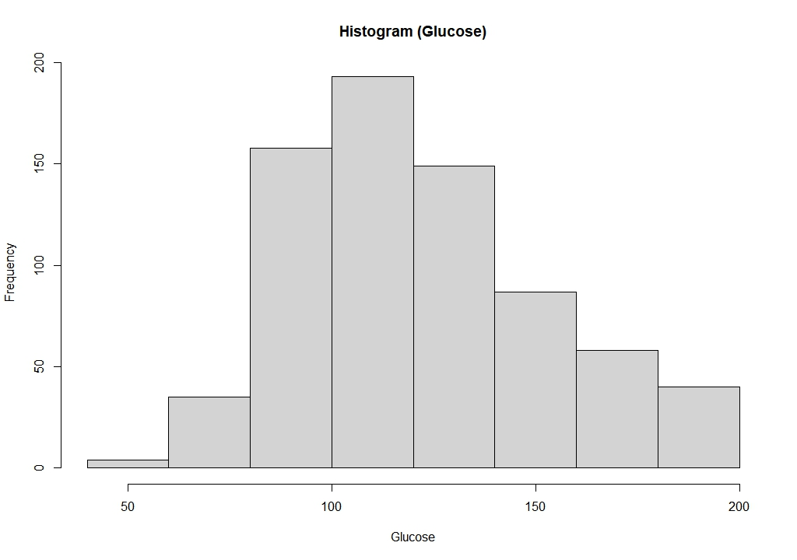
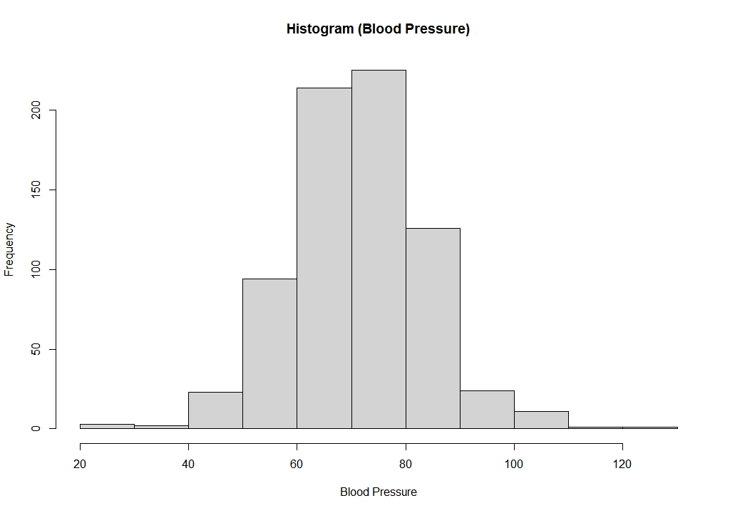
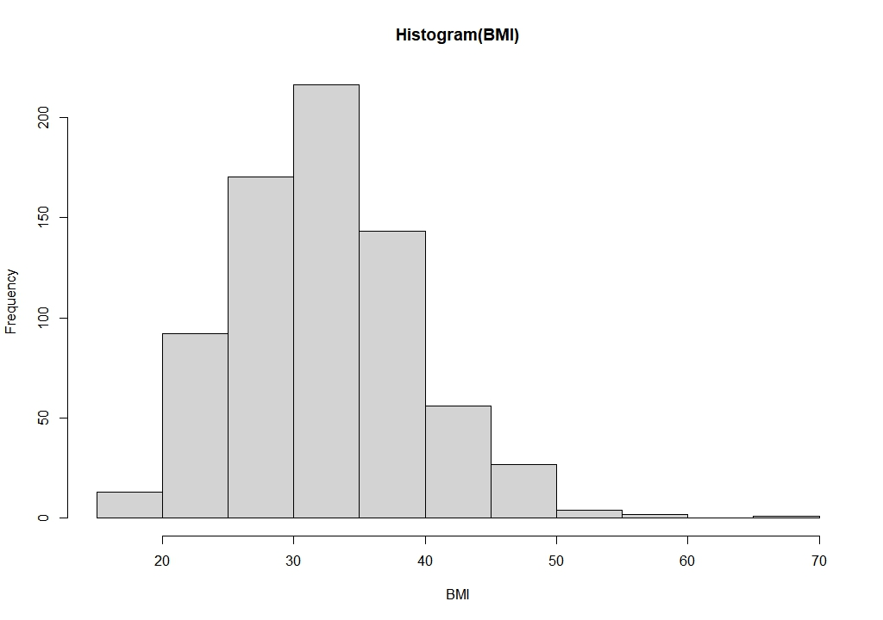
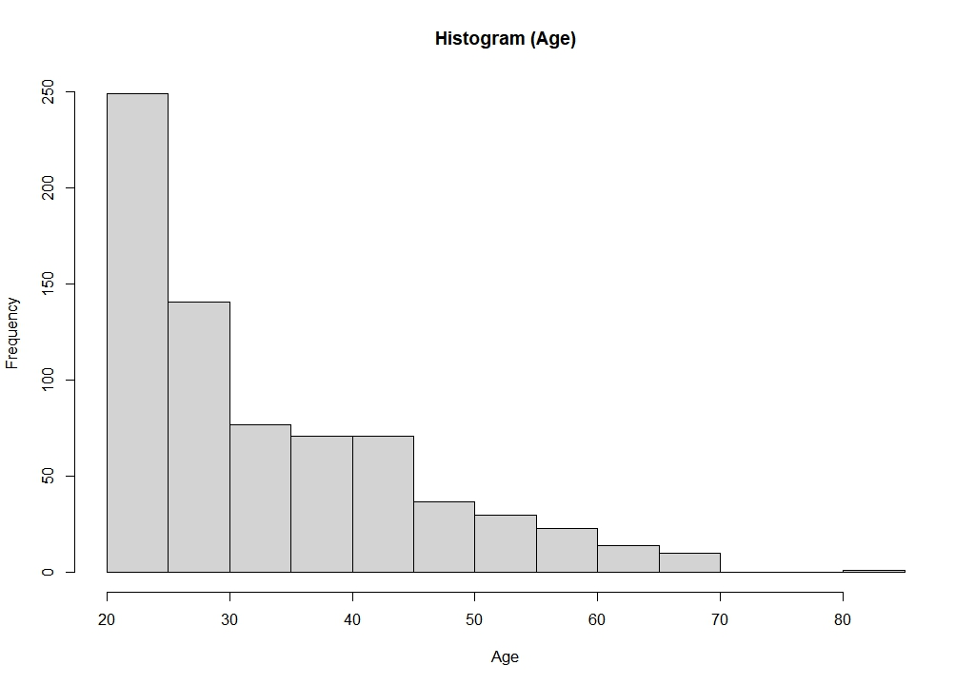
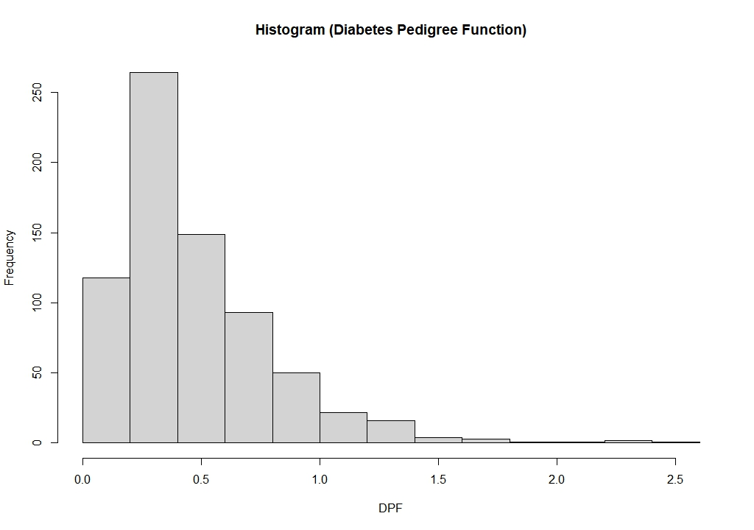
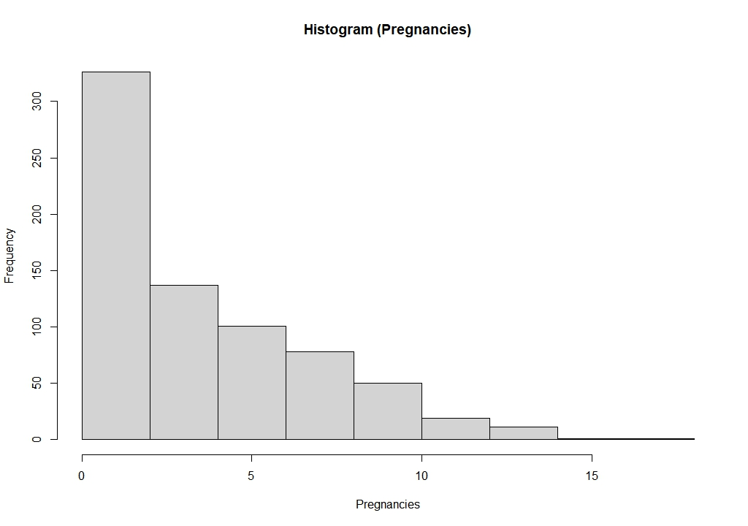
DISTRIBUTION ASSESSMENT
Glucose — broadly symmetric
Blood Pressure — approximately normal
BMI — moderate right skew
Age — strong right skew
DPF — heavy right skew
Pregnancies — count data, skewed
Notes:
Before choosing a correlation method for each variable pair, I assessed the distributions of all six continuous variables using histograms and Shapiro-Wilk normality tests. Glucose and Blood Pressure were approximately symmetric — these were candidates for Pearson correlation. BMI showed moderate right skew. Age, Diabetes Pedigree Function, and Pregnancies showed strong right skew. The Shapiro-Wilk test flagged all variables as non-normal, but at a sample size of 724, this test is extremely sensitive and detects even minor deviations. Visual inspection was therefore the primary basis for method selection. The key rule I followed: Pearson requires an approximately linear relationship with no severe violations — not perfect normality. Spearman was used where skewness or data type made Pearson inappropriate.

Slide 5
CORRELATION METHOD SELECTION
Three methods, justified by variable characteristics
Point-Biserial
Pearson
Spearman
When to use:
When to use:
When to use:
One binary variable (0/1)
Both continuous, approx. linear, no severe violations
Non-normal, count data, or monotonic relationship
Variable pairs:
Variable pairs:
Variable pairs:
· Outcome ↔ Glucose
· Glucose ↔ BMI
· Age ↔ Pregnancies
· Outcome ↔ BMI
· Age ↔ Blood Pressure
· Pregnancies ↔ BMI
· Outcome ↔ Age
· Pregnancies ↔ Glucose
· Outcome ↔ Blood Pressure
· DPF ↔ Glucose
· DPF ↔ BMI
Mathematically equivalent to Pearson when one variable is dichotomous
Scatterplots confirmed linear trends; mild heteroscedasticity noted for Age vs BP
Tied ranks present in Pregnancies — asymptotic p-values used
Notes:
I used three correlation methods, each chosen based on the characteristics of the variable pairs. Point-biserial correlation was used whenever diabetes status — a binary 0/1 variable — was one of the variables. This is mathematically equivalent to Pearson correlation with a dichotomous variable. Pearson correlation was used for two continuous variable pairs — Glucose vs BMI and Age vs Blood Pressure — where scatterplots confirmed approximately linear relationships without extreme outliers. I should note that Age vs Blood Pressure showed mild heteroscedasticity, which I acknowledged as a limitation. Spearman rank correlation was used for pairs involving Pregnancies or Diabetes Pedigree Function, because these variables had non-normal distributions or count-data characteristics. When tied ranks were present, R automatically used asymptotic rather than exact p-values, which is appropriate at this sample size.

Slide 6
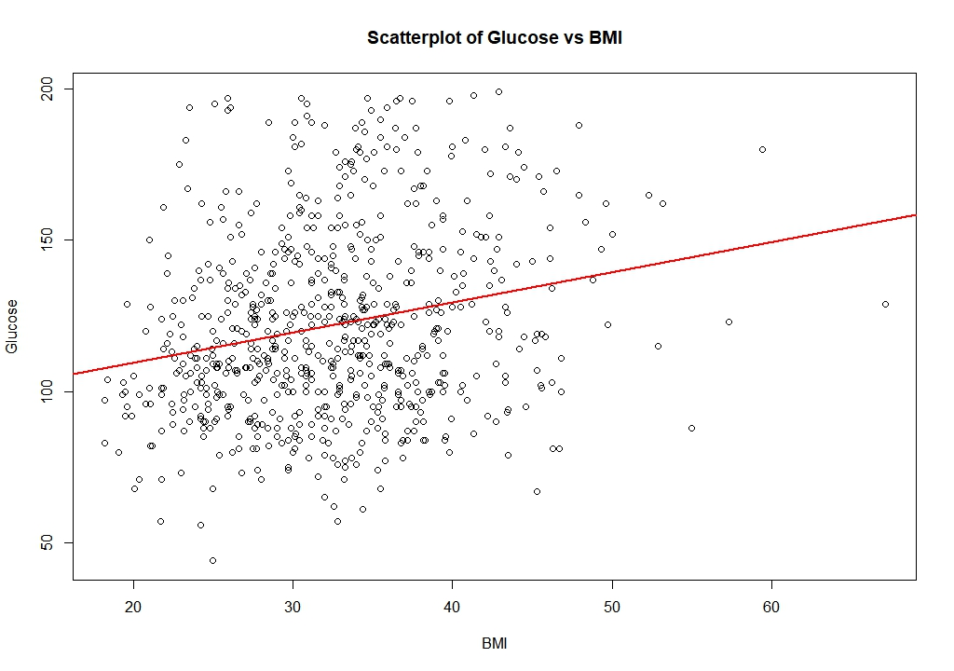
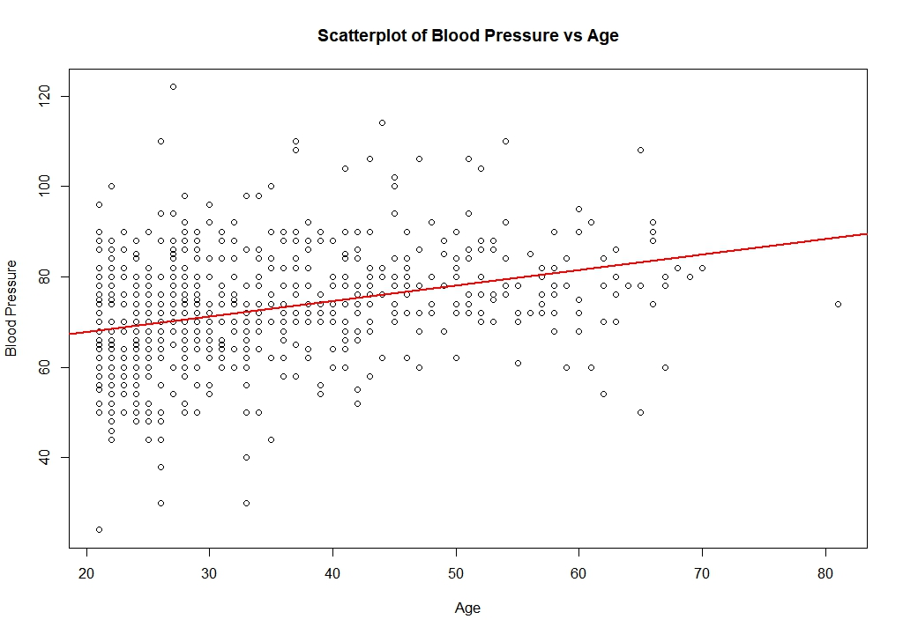
PEARSON ASSUMPTION CHECKS — SCATTERPLOTS
Glucose vs BMI
Blood Pressure vs Age
r = 0.223
Approximately linear · Pearson appropriate
r = 0.325
Linear trend present · Mild heteroscedasticity noted
Notes:
Before running Pearson correlation on Glucose vs BMI and Age vs Blood Pressure, I visually inspected scatterplots to confirm that a linear relationship existed. For Glucose vs BMI, the scatterplot showed a positive linear trend with substantial scatter around the line, but no evidence of extreme outliers pulling the result. Pearson was appropriate. For Age vs Blood Pressure, there was also a positive linear trend. However, I noticed that blood pressure values were more spread out at younger ages and less so at older ages — this is mild heteroscedasticity. I retained Pearson given the large sample size and the absence of severe violations, but I acknowledged this in my limitations. Both correlations were positive and statistically significant.

Slide 7
CORRELATION RESULTS — ALL 11 PAIRS
Variable Pair | Method | r / ρ | p-value
Outcome vs Glucose | Point-Biserial | 0.488 | < 0.001
Outcome vs BMI | Point-Biserial | 0.299 | < 0.001
Outcome vs Age | Point-Biserial | 0.246 | < 0.001
Outcome vs Blood Pressure | Point-Biserial | 0.167 | < 0.001
Glucose vs BMI | Pearson | 0.223 | < 0.001
Age vs Blood Pressure | Pearson | 0.325 | < 0.001
Age vs Pregnancies | Spearman | 0.617 | < 0.001
Pregnancies vs BMI | Spearman | −0.002 | 0.967
Pregnancies vs Glucose | Spearman | 0.138 | < 0.001
DPF vs Glucose | Spearman | 0.086 | 0.021 ⚠
DPF vs BMI | Spearman | 0.129 | < 0.001
⚠ DPF vs Glucose (p=0.021) is the weakest significant finding — interpret cautiously given no multiple-comparison correction was applied.
Notes:
Here are the full results across all 11 correlation pairs. Looking at the bar chart on the right, which shows the four point-biserial correlations with diabetes status: Glucose had the strongest association at r = 0.488 — a moderate positive correlation. BMI came second at 0.299, Age at 0.246, and Blood Pressure at 0.167. In the full table on the left, the strongest relationship in the entire study was actually Age vs Pregnancies at rho = 0.617 — but this is a relationship between two demographic variables, not with diabetes status. One result worth highlighting: Pregnancies vs BMI showed virtually no correlation at rho = negative 0.002, p = 0.967. This is a null result — despite a theoretical expectation that parity and body composition might be related, the data showed no association. I also want to flag that DPF vs Glucose had p = 0.021 — statistically significant, but it is the weakest finding in the study, and because I did not apply a multiple comparison correction across 11 tests, this result should be treated cautiously.

Slide 8
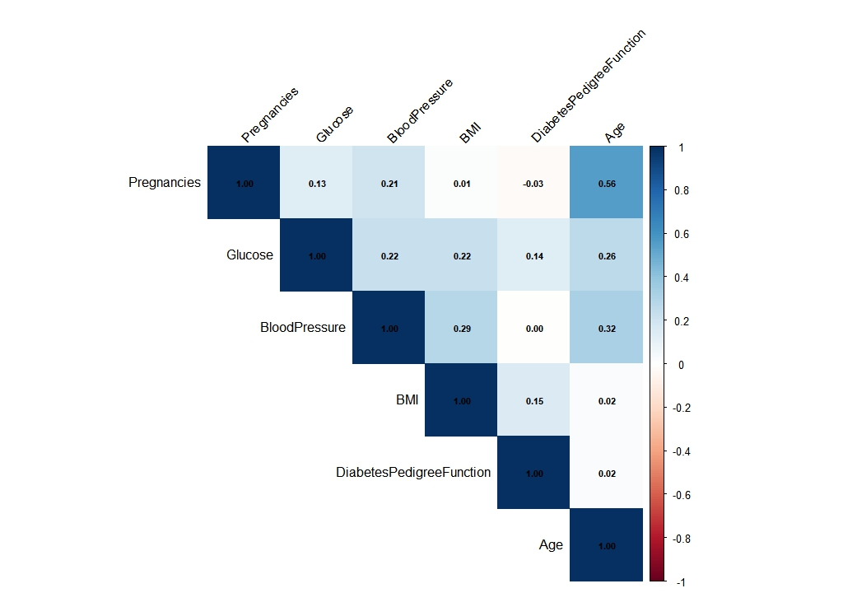
CORRELATION MATRIX — OVERALL PATTERN
Key Observations
Age ↔ Pregnancies: strongest inter-variable association (0.56 Pearson / 0.617 Spearman)
Age ↔ Blood Pressure: moderate positive relationship (0.32)
Glucose ↔ BMI: weak positive link through metabolic pathway (0.22)
Pregnancies ↔ BMI: effectively zero — null result confirmed (0.01)
DPF shows only weak associations with other variables
Note: heatmap uses Pearson coefficients for all pairs as a visual overview. Method-specific results in the table are the primary analysis.
Notes:
This heatmap gives a visual overview of all pairwise relationships among the six continuous variables — excluding the binary Outcome variable. The darkest cell is Age and Pregnancies at 0.56 — the strongest relationship among predictors. Age and Blood Pressure also show a moderate association at 0.32. Glucose and BMI show a weak positive relationship at 0.22, consistent with the Pearson result. Importantly, Pregnancies and BMI are essentially uncorrelated — the cell shows 0.01, confirming the null result from the Spearman test. One important note: this heatmap uses Pearson coefficients for all pairs. For some pairs — particularly those involving Pregnancies or DPF — I used Spearman in the actual analysis. The heatmap is a visual overview only. The numbers in Table 2 from the previous slide are the authoritative results.

Slide 9
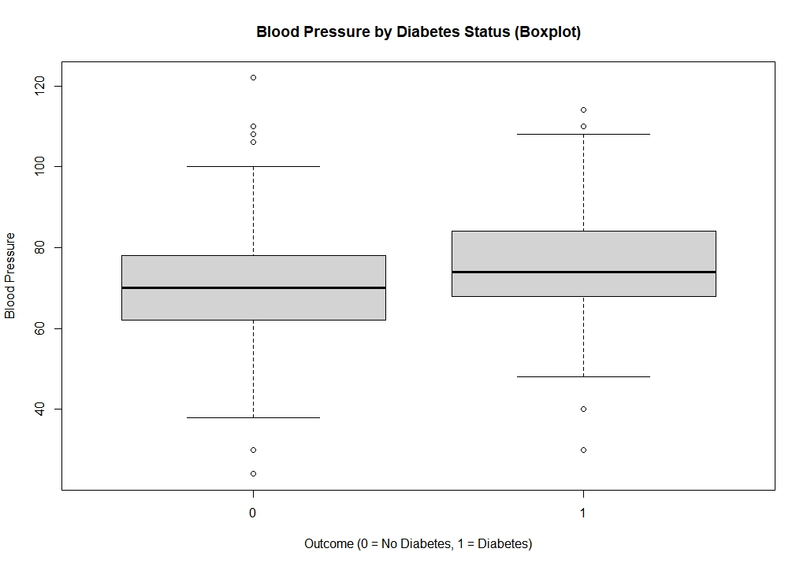
SUPPLEMENTARY ANALYSIS — BLOOD PRESSURE & DIABETES
Why This Matters
70.9 mmHg
Non-Diabetic Mean BP
75.2 mmHg
Diabetic Mean BP
4.3 mmHg
Difference
p < 0.001
Welch t-test
Key insight: correlation (r = 0.167) understates the group-level difference. Statistical significance ≠ clinical significance — 4.3 mmHg is a marginal clinical difference.
Notes:
Blood pressure had the weakest correlation with diabetes status at r = 0.167. That could make you think blood pressure is essentially unrelated to diabetes in this dataset. But correlation coefficients measure the strength of linear association across all individuals. They don't directly tell you whether the two groups differ. So I ran a supplementary group comparison. Diabetic women had a mean blood pressure of 75.2 mmHg, compared to 70.9 mmHg for non-diabetic women — a difference of about 4.3 mmHg. A Welch two-sample t-test confirmed this difference was statistically significant at p less than 0.001. However — and this is important — statistical significance and clinical significance are not the same thing. A 4.3 mmHg difference is below the typical clinical threshold of 5 mmHg for meaningful blood pressure differences. The boxplot shows heavy overlap between the two groups. So the conclusion is: blood pressure is associated with diabetes status at the group level, but it is a poor standalone discriminator between diabetic and non-diabetic individuals.

Slide 10
KEY FINDINGS
What the correlations actually tell us
1
Glucose is the strongest clinical signal
2
Demographic variables are internally related but weakly predictive
r = 0.488 with diabetes status — the highest correlation in the study. Reflects the biological centrality of glucose dysregulation in Type 2 diabetes.
Age ↔ Pregnancies: ρ = 0.617. Yet both show weak associations with diabetes status — demographic variables capture shared structure, not diabetes risk.
3
Pregnancies vs BMI: a null result worth reporting
4
DPF associations are real but fragile
ρ = −0.002, p = 0.967. Despite theoretical expectations, parity and body composition were entirely unrelated in this dataset.
Familial risk shows weak positive links with Glucose and BMI. DPF vs Glucose (p = 0.021) may not survive multiple-comparison correction.
Notes:
Let me summarize the four most important findings. First: Glucose is the strongest correlate of diabetes status at r = 0.488. This is clinically expected — diabetes is fundamentally a disease of glucose regulation. Second: Age and Pregnancies are strongly correlated with each other at rho = 0.617, but both are weakly associated with diabetes status. This is an important distinction — demographic variables describe the population's structure but contribute limited information about who has diabetes. Third: Pregnancies and BMI showed essentially zero correlation. This is a null result, and null results matter. It shows that parity and body mass are not meaningfully linked in this population, despite what you might expect from theory. Fourth: The Diabetes Pedigree Function showed only weak associations. The link with Glucose is statistically significant at p = 0.021, but this is the weakest finding in the study and may not be robust after accounting for multiple comparisons.

Slide 11
LIMITATIONS
L1
Cross-sectional data
L2
Missing data
Correlation does not imply causation. Directionality of relationships cannot be determined.
Listwise deletion reduced n from 768 to 724. Missingness may not be random, potentially introducing bias.
L3
Excluded variables
L4
Multiple comparisons
Insulin and SkinThickness were excluded due to excessive missingness. Important clinical information may be absent.
11 tests were run without Bonferroni or FDR correction. Weak findings (e.g. DPF vs Glucose, p=0.021) may be false positives.
L5
Heteroscedasticity
L6
Population specificity
Age vs Blood Pressure showed mild heteroscedasticity. Pearson coefficient should be interpreted with this caveat.
Results apply only to Pima Indian women. Generalization to other populations is not supported.
Notes:
I want to be transparent about the limitations of this study. First, because this is cross-sectional data, we can identify associations but cannot make causal claims. Glucose being correlated with diabetes status does not mean glucose causes diabetes in any directional sense — the association is bidirectional. Second, listwise deletion reduced my sample slightly and may have introduced bias if the missing values were not randomly distributed. Third, excluding Insulin and SkinThickness — while justified — means I may be missing clinically relevant information about insulin resistance and body fat distribution. Fourth — and I want to emphasize this — I ran 11 correlation tests without applying a multiple comparison correction. With that many tests, the probability of at least one false positive by chance alone is non-trivial. The DPF vs Glucose finding in particular should be treated with caution. Fifth, the mild heteroscedasticity in Age vs Blood Pressure means Pearson may not be the ideal method for that pair, though I judged it acceptable given the sample size. Finally, all findings are specific to Pima Indian women and should not be generalized.

Slide 12
CONCLUSION
Clinical variables are more informative
than demographic characteristics
for diabetes status.
Association hierarchy with diabetes status:
r = 0.488
r = 0.299
r = 0.246
r = 0.167
Glucose
BMI
Age
Blood Pressure
Future work: logistic regression to examine independent contributions of multiple risk factors simultaneously.
Notes:
To conclude: The study examined 11 correlation pairs across three methods — point-biserial, Pearson, and Spearman. The central finding is that clinical variables were more strongly associated with diabetes status than demographic or familial variables. Glucose showed the strongest association at r = 0.488, followed by BMI at 0.299, Age at 0.246, and Blood Pressure at 0.167. Demographic variables — particularly Age and Pregnancies — were strongly related to each other but weakly related to diabetes status, suggesting they capture shared demographic structure rather than diabetes-specific risk. Familial risk through the Diabetes Pedigree Function showed only weak associations and should be interpreted cautiously. Future studies could extend this work using logistic regression to simultaneously examine multiple risk factors and identify their independent contributions. Thank you. I am happy to take any questions.

Slide 13
REFERENCES
Field, A., Miles, J., & Field, Z. (2012). Discovering statistics using R. SAGE Publications.
Knowler, W. C., Bennett, P. H., Hamman, R. F., & Miller, M. (1978). Diabetes incidence and prevalence in Pima Indians: A 19-fold greater incidence than in Rochester, Minnesota. American Journal of Epidemiology, 108(6), 497–505. https://doi.org/10.1093/oxfordjournals.aje.a112648
R Core Team. (2025). R: A language and environment for statistical computing. R Foundation for Statistical Computing. Vienna, Austria. https://www.R-project.org/
UCI Machine Learning Repository. (n.d.). Pima Indians Diabetes Database. Retrieved June 22, 2026, from https://archive.ics.uci.edu/dataset/34/diabetes
World Health Organization. (2024, November 14). Diabetes. https://www.who.int/news-room/fact-sheets/detail/diabetes
Notes:
References slide — no need to read these aloud. Simply mention that full references are available and were cited throughout the report.

